Slide 1
ALP WORKSHOP VII
External Agent Liaison: the CoABS Grid
Technical Track
Breakout Session 4
December 7, 2000
Presented by
Brandon L. Buteau
Litton PRC

Slide 2
External Agent Liaison
Session objectives:
  Present technical objectives and progress associated with the interoperation of ALP societies with external agents and agent-based frameworks
  Solicit feedback about alternatives for both increased technical sophistication and improved functional capability
Session agenda:
  Technical Objectives
  Technical/Domain Presentation
  Liaison Demonstration
  Results and Lessons Learned
  Future Directions and Discussion

Slide 3
Technical Objectives
Develop generic agent-oriented external interface capability between ALP and non-ALP systems based upon Jini/JavaSpaces
Demonstrate example of new interfaces compatible with the CoABS Grid
  Pre-existing Grid agent or service
  Functionally relevant to ALP logistics domain
Develop a GUI for managing service visibility and access control

Slide 4
ALP Liaison Concept
Operations
Director
Support
Manager
Non-ALP
Requirement
Agent
Supply
Team
Repair
Team
Transport
Team
Non-ALP
Service
Agent
Subordination
Operations
Team-2
Provider
Operations
Team-1
Jini “wrapper”
External Service
External Director

Slide 5
Solution Constraints
Compatible with CoABS without being bound to it
  Generic interactions
Compatible with ALP
  Integrated with PlugIns
  Allow flexible, dynamic external relationships
    Cluster as agent(s)
    Multiple external agents and societies
Abstracted capabilities for arbitrarily complex, multi-threaded interactions
Global view for liaison administration

Slide 6
Technical Approach Overview
CoABS
Named JavaSpace
Liaison
Admin GUI
Non-ALP
Agents
Jini Lookup
Service
ALP
Society
Liaison
PlugIns
Service
Map
PSPs
ALP
GUIs
Other
ALP
Clusters
Ex/Ag/Al/As
PlugIns
LDM
PlugIns
Data
Sources
LogPlan
ALP Cluster

Slide 7
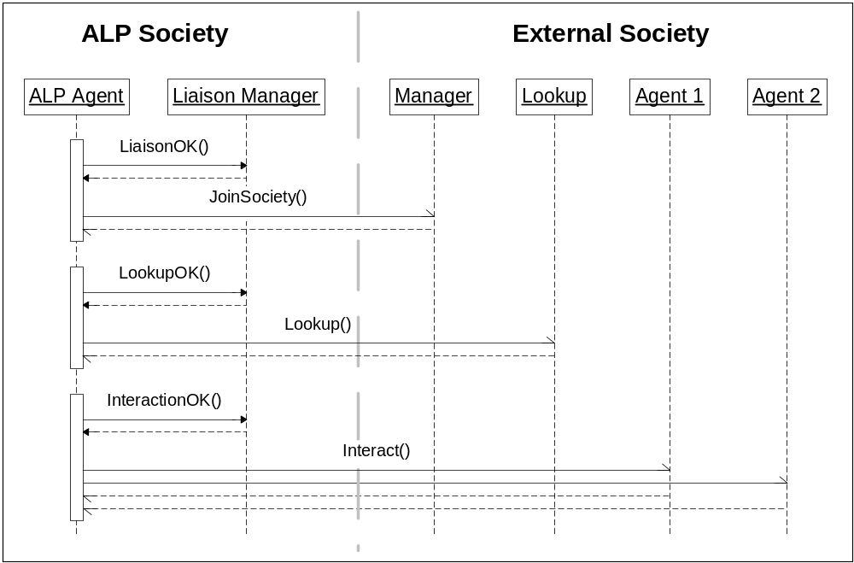
Generic Agent Interactions

Slide 8
Technical Elements
Sun’s Jini
  Attribute-based directory service
  Proxy repository
  Automated administration support
JavaSpace
  Tuple-based distributed data structures
  Persistence
  Transaction support

Slide 9
CoABS Grid
Vision: applications formed dynamically out of heterogeneous components (agents, objects, legacy systems) customized to task/situation at hand
Focus on interoperability
Lightweight
Simple interfaces
Expanding set of embedded services
Demonstration applications (TIEs)
  Coalition operations
  Disaster relief

Slide 10
Grid Technical Features
Augmented Jini lookup service
  APIs simplify Jini lookup interactions
Direct service invocation through proxies
Direct message passing through proxies
  Non-persistent
  Queuing
Logging, visualization
No requirements for standardized agent communication language (ACL)
  Translation onus stays with agents

Slide 11
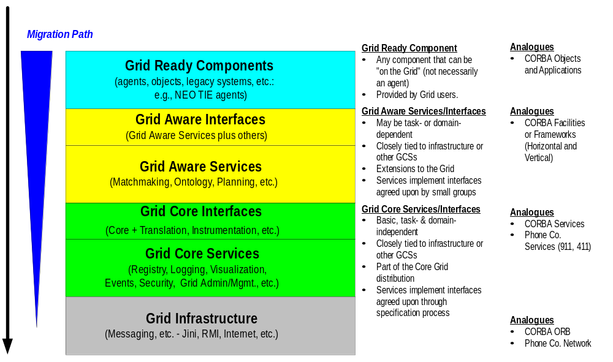
Grid Technical Architecture

Slide 12
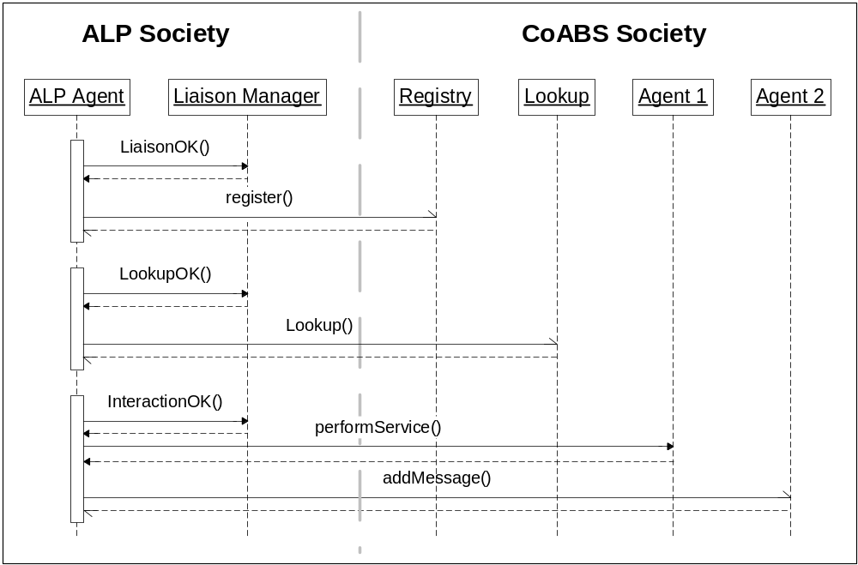
ALP / CoABS Interactions

Slide 13
Key Liaison Classes
SimpleLiaisonPlugIn
LiaisonManager
LiaisonDeputy
Interactor
Interaction

Slide 14
SimpleLiaisonPlugIn
Integrates external liaison functions within the ALP environment
Full access to LogPlan
Permits flexible external relationships
  Multiple ALP agents per cluster or PlugIn
  Multiple external liaisons per cluster or PlugIn
Flexible extension of SimplePlugIn
  Specifies single threading model
  Provides access to a LiaisonManager

Slide 15
LiaisonManager
Provides functions for liaison administration
  Access to an administration JavaSpace shared across the ALP society
  Monitors overall ALP agent liaison enablement
  Handles ALP agent parameters, names, identification data
Provides a service proxy for the liaison Jini lookup server (currently unused)
Provides access to LiaisonDeputy instances

Slide 16
LiaisonDeputy
Provides housekeeping and utility functions for interactions with an entire class of external societies
  Testing current liaison status of ALP agents for each potential/actual external liaison
  Tracks ongoing interactions between ALP agent and external society
Subclassed for specific society types
  CoABS (implemented)
  ALP, RETSINA, …
CoABSLiaisonDeputy handles CoABS message-handling callbacks

Slide 17
Interactor
An interface for an object that knows how to perform a specific kind of interaction with an external agent
  Example: CoABSLookupInteractor
Generic action methods
  begin(), send(), receive(), normalEnd(), abnormalEnd()
State represented by arbitrary object
  Each action consumes and produces a state
  nextAction()
Executes in context of an instance of an interaction thread
But can be multi-threaded

Slide 18
Interaction
An instance of a dynamic, bounded sequence of liaison actions by an interactor
Each action of the interactor produces a new state
  Start with begin()
  nextAction() picks next interactor action to perform
  Continue until normalEnd() or abnormalEnd()
Actions typically produce and save some intermediate and final results with a LiaisonDeputy
Can be started synchronously (wait for completion) or asynchronously (poll for completion)

Slide 19
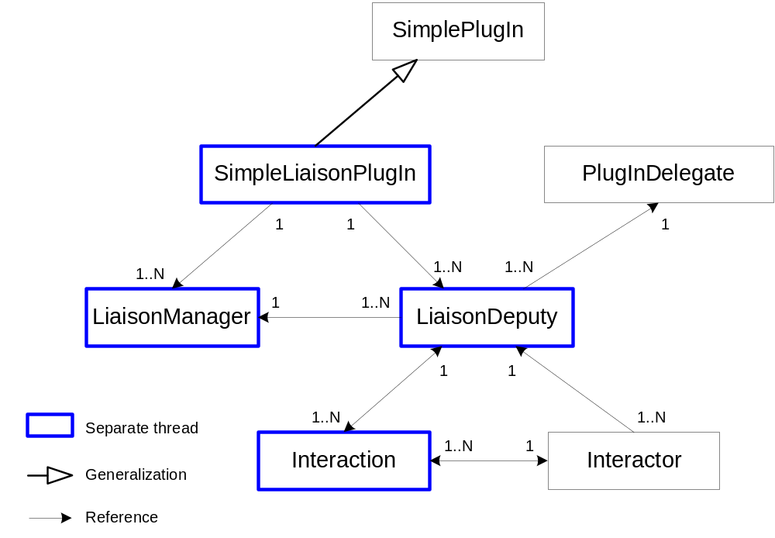
Partial Technical Solution

Slide 20
Liaison Administration Needs
Impractical and insecure to allow unrestricted interactions between ALP and external agents
Support global viewpoint (across ALP and external societies) for identifying and specifying liaison status
  ALP agents initiating interactions
  External agents initiating interactions
Status must be administered without requiring ALP agents to identify potential liaisons a priori
Status must be persistent
  Repeated ALP agent invocation
  Failure/shutdown/restart of administration tools

Slide 21
JavaSpace-based Administration Interface
JavaSpace is a Jini-based service that is persistent and transaction-safe
Provide a single liaison JavaSpace for an ALP society to handle interface between ALP agents and global administration tool
ALP agents (via LiaisonManager) identify themselves by placing descriptive entries in the JavaSpace
  An ALP agent registry
ALP agents (via LiaisonDeputy) check status entries in the JavaSpace to test permissions for interaction with external agents

Slide 22
JavaSpace Components
Agent references
  Nomenclature by society, neighborhood, agent
  Unique identifier
  Partial references specify society or neighborhood
ALP Agent references
  Liaison enablement
  Permission delegation
External agent references
Liaison status references join ALP and external agents
  ALP can initiate interaction
  ALP can respond to interaction

Slide 23
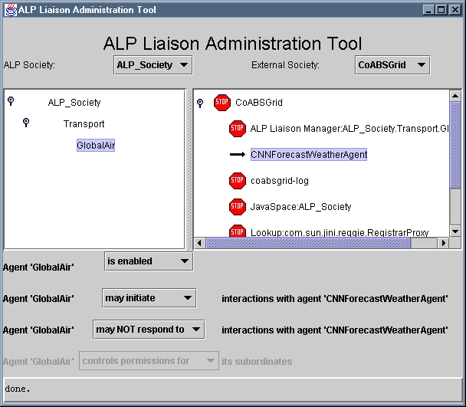
Liaison Administration GUI

Slide 24
Choosing an External Agent
Ideal criteria
  Pre-existing CoABS Grid-ready component
  Some domain overlap or cross-domain impact with ALP (both in function and situation)
  Ability to deal with real-world details (no toys)
  Simple enough to achieve interoperability in a few weeks
  Not another legacy system interface that could be better handled via an ALP LDM PlugIn
Over-constrained!
Eventually selected information agents from a weather domain

Slide 25
Why the Domain of Weather?
Weather has a significant affect on real-world logistics
Not currently used by ALP (no duplication of effort)
Easy to identify possible points of impact on plan
  Therefore, possible interoperation points within an ALP society
Potentially, multiple dynamically updated sources
Representative of a larger class of information collection and assessment domains
Pre-existing CoABS Grid agents that acquire weather information

Slide 26
Weather Plan
Weather-
Affected
Tasks
…
…
L1
D1
L2
D2
L2
D2
L2
D2
L3
D3
Scheduled
Locations
L3
D3
L4
D4
L3
D3
L3
D3
L4
D4
Weather
Requirements
Aggregated
Forecast
Tasks
Results

Slide 27
Weather PlugIns
WeatherRequirementPlugIn
  Captures forecast requirements for each location of each affected task
RequirementAggregationPlugIn
  Builds aggregation/composition of overlapping requirements for same locations
WeatherLiaisonPlugIn
  Establishes liaison with CoABS
  Finds a forecast agent (lookup)
  Queries and receives forecast results
WeatherTrigger
  Modifies tasks affected by forecast results

Slide 28
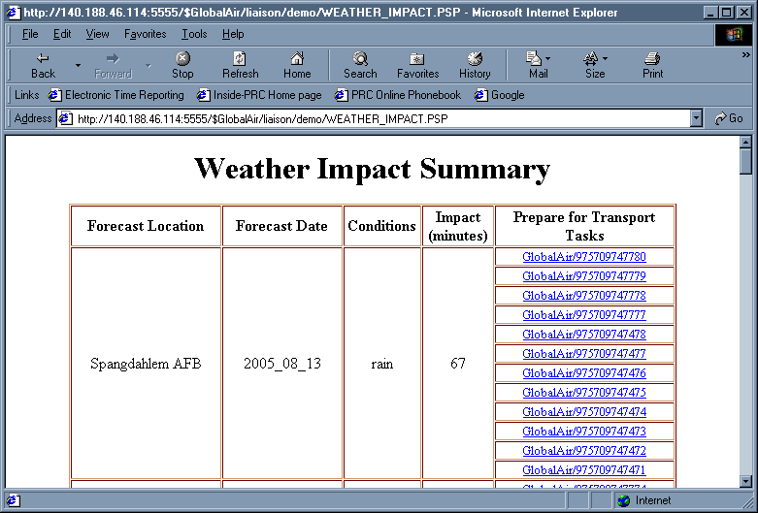
Demonstrate LogPlan Impact

Slide 29
RETSINA Weather InfoAgent
REusable Task Structure based Intelligent Network Agent architecture from CMU
InfoAgents locate, extract, and supply information from non-RETSINA sources (e.g., Web pages)
Functions under control of its own agenda and planning system
Interacts with the CoABS Grid through a RETSINA Interoperator agent
Weather InfoAgent extracts weather forecasts from a commercial Web site (CNN)

Slide 30
Weather Queries
(ask-one
:sender ALP_Society.Transport.GlobalAir
:receiver CNNForecastWeatherAgent
:content (objective :name "getInformation"
:parameters (listof (pval "primary-keys" "(eu/Italy/AvianoPNLIYW)")))
:reply-with RETSINAWeatherInteractor_098759951989
:in-reply-to
:language default-language
:ontology default-ontology)

Slide 31
Forecast Replies
(REPLY
:language default-language
:reply-with
:client InterOp
:info (objective :name "getInformation"
:parameters (listof (pval "primary-keys" "(eu/Italy/AvianoPNLIYW)")))
:receiver InterOp
:ontology default-ontology
:in-reply-to RETSINAWeatherInteractor_098759951989
:content (reply
:city (eu/Italy/AvianoPNLIYW)
:weather-url (http://www.cnn.com/WEATHER/eu/Italy/AvianoPNLIYW.html)
:weather (forecast :days (WED THURS FRI SAT SUN)
:conditions (p/cloudy cloudy rain p/cloudy p/cloudy))) :server CNNForecastWeatherAgent
:sender CNNForecastWeatherAgent)

Slide 32
RETSINA Agent Society
Agent Name
Service (ANS)
Weather
Web Site
Matchmaker,
Visualizer,
…
Interoperator
Weather
InfoAgent
Non-RETSINA
Agents
Internet

Slide 33
ALP / RETSINA Interactions
CoABS Services
Registry
Lookup
Logging
RETSINA Society
ALP
Society
Interoperator
Weather
InfoAgent
Weather-
affected
Cluster

Slide 34
Demonstration
CoABS Grid
  Registry, lookup, and logging
RETSINA ANS, Weather InfoAgent, and InterOperator
ALP AEF Society (standalone version)
  GlobalAir cluster enhanced with weather requirements, external liaison, and forecast impact adjustments
Liaison Administration Tool

Slide 35
Demonstration

Slide 36
Results – Capability
Initial objectives were achieved
  ALP is now Grid-ready
  Basic demonstration of external agent liaison
Technical solution is extensible
  Not limited to Grid or Jini
Basic facility for liaison administration
RETSINA InfoAgent was easy to use
  Required tweaking
Brought weather information into the ALP environment

Slide 37
Results – Performance
Round-trip interaction time from ALP to InfoAgent through Interoperator ~ .65 seconds
Excludes
  Loading/parsing HTML data
  Logging with the Grid
Includes
  Checking liaison status in JavaSpace
  RETSINA scheduling/planning activity
  Substantial debug output at RETSINA end

Slide 38
Where’s the Service Map?
Simple answer: not an issue yet
  Weather tasks not part of prior ALP domains, so nothing to map
  No external agents exist that levy requirements on ALP
But still needs to be resolved
Dependent upon rapidly evolving standards and capabilities
  FIPA interaction protocols
  DAML
  Translation services

Slide 39
Lessons Learned
CoABS Grid is effective and easy to use
  APIs simplify use of Jini
Primary technical challenges
  Translating information
  Lack of common ontologies
  Pushing agents beyond their design envelope
Pragmatic issues
  Enforcing simulation time on external agents
  Conflicting version requirements for “common” software or languages

Slide 40
Special Acknowledgment
The RETSINA development team at CMU

Slide 41
Technical Directions
More sophisticated interaction with InfoAgent
  Monitor-style queries vs. polling
More sophisticated interaction with RETSINA
  Matchmaker
  Bypass CoABS?
Persistence
  Place interaction state in LogPlan
Externally-initiated interactions
  Requires a new kind of external agent
Time-bounded interactions

Slide 42
Technical Directions (cont.)
Translation interactions
  External translation agents/services
Nested interactions
  Common need to compose lookup and translation with functional interactions
  Multi-party, multi-phase interactions
Interaction protocols
  Subclass Interaction for different standard patterns of interaction state changes
  ALP cluster/cluster interactions?

Slide 43
Technical Directions (cont.)
Quality of service
  Integrate with ALP QuO services
  Interaction metrics
Limited security improvements
  Configuration file additions
  Stronger security depends upon developments in Jini security, ALP security, Ultra*Log
Scalability improvements in administration GUI

Slide 44
Functional Directions – ALP
More realistic weather impact
  Integration with in-depth transportation planning
  Non-aviation and non-transportation impact
Time-aggregated forecast queries
Time-phased results
Data quality
  More distant forecasts are more uncertain
  Integrate with ALP meta-data
Updated requirements and forecasts over time
Multiple information sources

Slide 45
Functional Directions – External
Different RETSINA InfoAgent
  Greater forecast coverage in time/space
Weather from direct NWS sources
  AWIPS
  Simulated data challenge
Other CoABS agents
  Military planning domains
ALP agents as “external” agents
  Multiple ALP societies
  Books On Line?

Slide 46
Summary
ALP is capable of interacting in more sophisticated ways with external systems, objects, agents
  With a flexible collection of new classes for building and managing these interactions
The CoABS Grid is an effective framework that facilitates agent interoperability
  Strong need for better standards (languages, ontologies) or for translation services
Many possible directions for further work

Slide 47
Discussion

Slide 48
Backup

Slide 49
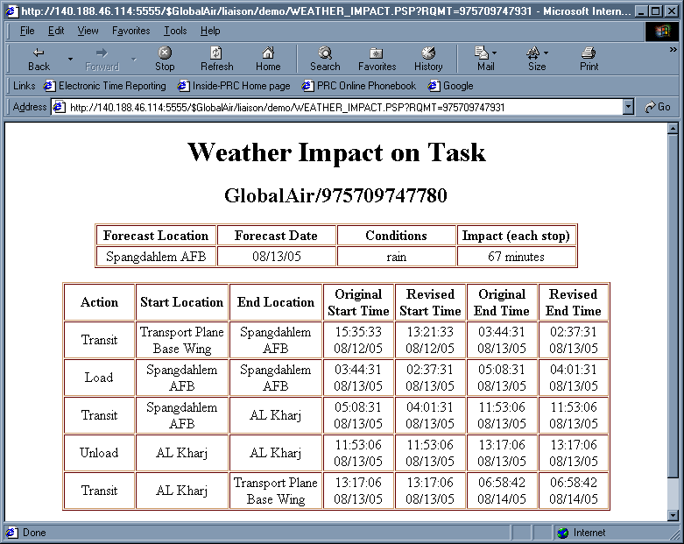
Detailed Itinerary Impact

Slide 50
Code Example
// Setup liaison with CoABS Grid
LiaisonManager mgr = createLiaisonManager();
CoABSLiaisonDeputy dep;
dep = (CoABSLiaisonDeputy) mgr.createLiaisonDeputy(LConstants.COABS_SOCIETY,
getDelegate(),
getParameters());
mgr.start(true);
dep.start(“ALP_Society”, null, true);
// Register with the Grid
CoABSRegistryInteractor reg = new CoABSRegistryInteractor(dep);
Interaction regInt = new Interaction(dep, reg, dep.externalManager());
regInt.start(true);
// Find the RETSINA forecast agent
CoABSAgentDescription desc = new CoABSAgentDescription();
desc.name = “CNNForecastWeatherAgent”;
CoABSLookupInteractor lookup = new CoABSLookupInteractor(dep, desc);
Interaction lookInt = new Interaction(dep, lookup, dep.externalManager());
Vector weatherAgents = (Vector) lookInt.start(true);

